Slide 1
Introduction to Firewalls and Network Security
Network Security Day 1

Slide 2

Class Objectives
By the end of today’s class, you will be able to:
Explain how open ports contribute to a machine’s attack surface.
Use firewalls to protect a machine’s open ports.
Develop and implement firewall policies with UFW and firewalld.
‹#›
Notes:
shutterstock_1214853796

Slide 3

Limits of Cryptography
Last week, we learned how cryptographic tools help maintain
confidentiality, integrity, and availability of data
at rest and in transit.
1
Confidentiality
Suppose a malicious actors attempted to hack into a hospital's web server in order to perform a ransomware attack.
In an effort to keep the private health information of their patients secure, the hospital protects secured access to its website using a cryptographic RSA VPN connection.
While these tools are important, cryptography is only a part of a multifaceted network defense ecosystem used to protect private information and critical network infrastructure.
2
Integrity
INFORMATION
SECURITY
3
Availability
‹#›

Slide 4

The Need for Network Security
While cryptographic applications help protect private data and critical network infrastructure from specific network attacks, other aspects of website security remain at risk.
For example, suppose the same website is the target of a denial of service (DoS) attack. Cryptography defenses aren't of much use.
Therefore, security practitioners need to implement network security strategies like firewalls that provide an additional layer of defense.
‹#›
Notes:
shutterstock_1085385533

Slide 5
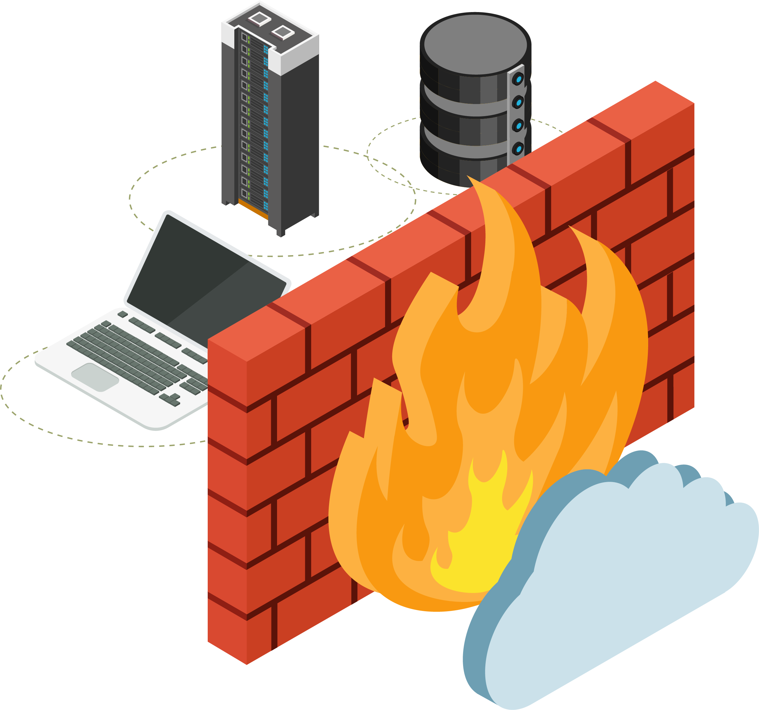
Firewalls
Firewalls are a technical security control that distinguish between trusted and untrusted network traffic and network connections.
Notes:
Shutterstock_792833623

Slide 6
Network Security is the process of taking physical and software preventative measures to protect the underlying networking infrastructure from unauthorized access, misuse, malfunction, modification, destruction, or improper disclosure, thereby creating a secure platform for computers, users and programs to perform their permitted critical functions within a secure environment.
’
’
’
’
- SANS Network Security Resources

Slide 7

As we’ll see, firewalls are the first line of defense on the perimeter of the network's edge.
However, they are merely the first layer upon which others preventive and protective layers are built.
‹#›
Notes:
shutterstock_1223369179

Slide 8
Defense in Depth
In the GRC unit, we covered how defense-in-depth plays a critical role in securing organizations. Throughout this unit, we will apply a DiD mindset to layer security measures that aims to slow an attacks progression, thus providing network defenders with enough time to respond.
Perimeter
Network
Host
Application
Data
‹#›

Slide 9
Defense in Depth
In this unit, we will learn how to apply a defense-in-depth methodology to create expansive layers of network security.
01
02
03
Today, we will cover the benefits, limitations, for various types of firewalls.
On Day 2, we will introduce intrusion detection systems (IDS) and network security monitoring (NSM). NSM is particularly useful for tracking an adversary through the network after a breach.
On Day 3, we’ll conduct advanced cyber threat hunting using Enterprise Security Management (ESM), which expands upon NSM through the inclusion of endpoint telemetry.
‹#›

Slide 10
Today’s Class
Today’s class will progress as follows:
How open ports contribute to a machine's attack surface.
How firewalls are used to protect a computer's open ports.
Usage of different types of firewalls and their application.
The role firewalls play within a layered defense.
The development and implementation of firewall policies using UFW and firewalld.

Slide 11

Network Security
Knowledge of computer networking is essential for the following technical roles:
Help Desk/IT Specialist Knowing if and how firewalls affect user traffic can help with troubleshooting issues like slow connections, lack of connection, and broken networked applications, such as Skype or Facebook Messenger.
System/Network Administrator Often determine who is allowed to access devices on a network. These roles must
develop firewall policies and implement
them, using tools like UFW or firewalld.
Penetration Testers Must know if a firewall is between them and their target in order to launch a successful attack against a network, as well as which rules are enabled.
SOC Analyst Need to understand how firewalls on the network filter incoming and outgoing packets in order to accurately interpret traffic logs.
‹#›
Notes:
shutterstock_1032637258

Slide 12
Defense in Depth

Slide 13
Firewall Architecture and Defense Methodologies

Slide 14

Ports Recap
Networks allow computers to communicate with one another by sending data to and from open ports on other machines.
Devices must expose open ports in order to communicate
with other machines on the network.
We can’t assume that the only people who will connect to a device are those you trust.
Malicious actors will exploit this assumption to access sensitive information.
Restricting access to open ports is a fundamental skill for any technical security specialist.
‹#›
Notes:
Shutterstock_176521037 and shutterstock_160163327.eps

Slide 15


Firewalls
Firewalls provide a layer of protection by analyzing data leaving and entering a network.
They are placed between application servers and routers to provide access control.
Protect trusted networks by isolating them from untrusted networks, like the internet.
‹#›
Notes:
shutterstock_792833623

Slide 16

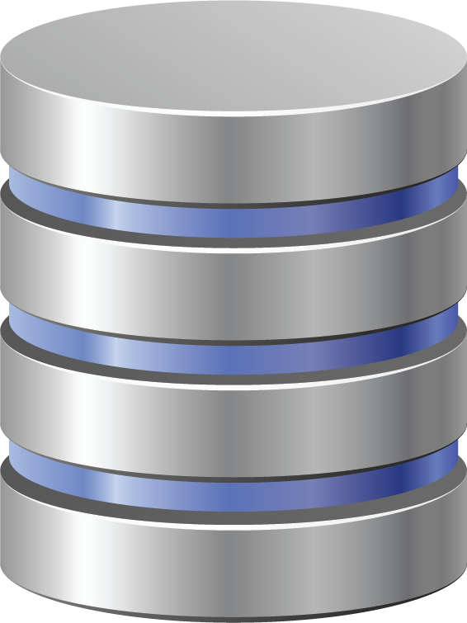

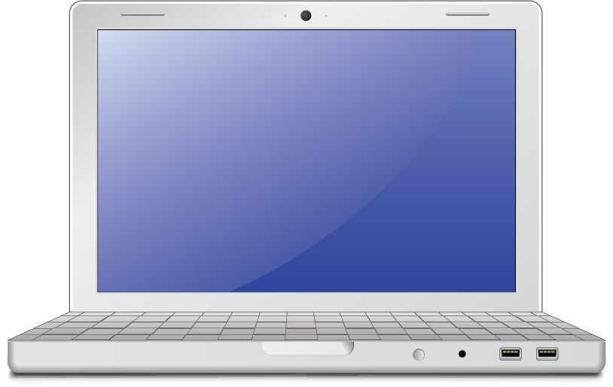

Firewalls
Firewalls can be used to either control access to a single host (host-based firewall) or an entire network (network firewall).
Network firewall Placed in front of a router to block malicious internet traffic from entering the private network.
Host-based firewall Runs on the machine that it blocks traffic to and from.
LAN
‹#›
Notes:
AdobeStock_41735567, shutterstock_1214853796, shutterstock_1580200669

Slide 17
Firewalls
Network-based and host-based firewalls work in the same way:
01
02
03
Intercept traffic before it reaches its target host or router.
Inspect the source and destination address and ports, TCP flags, and other features of the incoming packets.
Allow packets that come from trusted sources and deny packets that don't.
‹#›

Slide 18
Firewalls on the OSI
7
Application
Firewalls are a multifunctional network security appliance that operates at multiple layers of the OSI model.
They can be broken down into four basic types:
MAC
Packet filtering
Circuit-level gateways
Application gateways
6
Presentation
Application gateways
Circuit gateways
5
Session
4
Transport
Packet-filtering (Stateless and Stateful)
3
Network
MAC layer filtering
2
Data Link
1
Physical
‹#›

Slide 19
MAC Layer Firewall
MAC firewalls operate on Layer 2 of the OSI and filter based on source and destination MAC addresses.
7
Application
6
Presentation
5
Session
4
Transport
3
Network
Remember: The Media Access Control (MAC) address is a unique hardware ID that helps communicate with each other.
2
Data Link
1
Physical
‹#›

Slide 20



MAC Layer Firewall
Routers compare the MAC address of a device against an approved list. If there is a match, the traffic is forwarded to that device.
Advantages
Can secure the network from novice attackers.
Disadvantages
Can be easily bypassed by MAC spoofing.
‹#›

Slide 21
Packet-Filtering Firewalls (Stateless)
Stateless packet-filtering firewalls operate between Layer 3 and Layer 4 of the OSI model.
These firewalls statically evaluate the contents of packets and do not keep track of the state of a network connection (aka stateless).
7
Application
6
Presentation
5
Session
Use rules based on individual packets:
Source and destination IP address
Source and destination port information
IP protocols
Ingress and egress interface
4
Transport
3
Network
2
Data Link
1
Physical
‹#›

Slide 22
Packet-Filtering Firewalls (Stateless)
Stateless packet-filtering firewalls create checkpoints within a router and examine packets as they progress through an interface. If the information does not pass the inspection, it is dropped.
Advantages
Not resource intensive, meaning they are low-cost and do not have a significant impact on system performance.
Work best with small networks.
Disadvantages
Easy to subvert compared to more robust firewalls. Only operate at the network layer.
They are vulnerable to spoofing and do not support custom based rule sets.
‹#›

Slide 23
Packet-Filtering Firewalls (Stateful)
Stateful packet-filtering firewalls operate on Layer 3 and Layer 4 of the OSI model.
7
Application
6
Presentation
Stateful firewalls can determine if a packet is:
Trying to establish a new connection, known as a NEW state.
Part of an existing connection, known as an ESTABLISHED state.
Is neither a new or existing connection, known as a rogue packet.
5
Session
4
Transport
Rather than look at individual packets, stateful firewalls examine the connection as whole, looking at streams of packets.
They inspect the packets’ conversation and routing tables and use a combination of TCP handshake verification and packet inspection technology.
3
Network
2
Data Link
1
Physical
‹#›

Slide 24
Packet-Filtering Firewalls (Stateful)
Since stateful firewalls understand the context of the entire data stream, they can determine which application layer protocols are in use.
However, they cannot actually understand application layer protocols, and therefore can't determine what the underlying traffic is doing. While they can identify that a connection is using HTTP, it cannot identify if the connection is being used to request an HTML file or a PNG image.
Advantages
Offer transparent mode, which allows direct connections between clients and servers.
Disadvantages
Are resource-intensive systems.
‹#›

Slide 25
Circuit-level firewalls
Circuit-level firewalls operate at
Layer 5 of the OSI model.
Circuit-level gateways work by verifying the three-way TCP handshake.
TCP handshake checks can verify the following about a source:
Unique session identifier
State of the connection (Handshake established, closed)
Sequencing information
7
Application
6
Presentation
5
Session
These firewalls only look at the header of a packet. Once the circuit is allowed to establish an end-to-end connection, all data is tunneled between parties.
4
Transport
3
Network
2
Data Link
1
Physical
‹#›

Slide 26
Circuit-level firewalls
By verifying the three-way TCP handshake, they ensure that session packets are from legitimate sources.
Advantages
Quickly and easily approve
and deny traffic without consuming significant computing resources.
Relatively inexpensive and provide anonymity to the private network.
Disadvantages
Do not check the contents of the packet.
If a packet contains malware but has the correct TCP information, the data is allowed to pass through.
‹#›

Slide 27
Application (Proxy) Firewalls
Application or proxy
firewalls operate at Layer 3 through Layer 7 of the OSI model.
They inspect the actual contents of the packet, including authentication and encryption components
7
Application
Proxy firewalls use deep packet inspection and stateful inspection to determine if incoming traffic is safe or harmful.
They intercept all traffic on its way to its final destination, without the data source knowing. A connection is established to the proxy firewall, which inspects the traffic and forwards it if it's determined to be safe, or drops it if it's determined to be malicious
6
Presentation
5
Session
4
Transport
3
Network
2
Data Link
1
Physical
‹#›

Slide 28
Application / Proxy Firewalls
Proxy firewalls create an extra layer of protection between the traffic source and its destination behind the network by obscuring the destination from the source creating an additional layer of anonymity and protection for the network.
Advantages
More secure than other implementations and provide simple log and file audit management for incoming traffic.
Disadvantages
Resource intensive, requiring robust modern hardware and high costs. Bypassed with encryption.
‹#›

Slide 29
UFW
‹#›

Slide 30
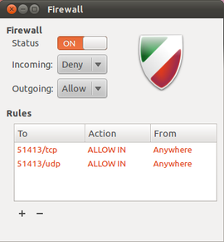
Uncomplicated Firewall (UFW)
UFW is a multifunctional firewall that provides stateless and stateful packet filtering.
It works on all kinds of network address and port translation, such as Network Address Translation (NAT) and Network Address Protection (NAP).
It is a standard Linux firewall, available by default in the latest Ubuntu installations.

Slide 31
Uncomplicated Firewall
UFW provides the following features:
Term | Definition
Host-Based | UFW is most commonly used on hosts.
Logging | UFW has the ability to generate multi-level logs, providing great insight into attacks.
Remote Management | Firewalls can be remotely managed. For example, through SSH via port 22. (Security concern?)
Rules for Allow / Deny | Examines source and destination IP addresses, port numbers, and packet types, all without opening the packet. Also uses TCP handshake, packet inspection.
Rate-Limiting | Supports rate-limited connections to protect from brute force attacks.

Slide 32
UFW Demo
In the next demo, we will work with the following scenario:
The IT department is hosting a website that requires the use of both normal and encrypted web traffic.
Your CISO has released a security advisory authorizing the use of secured remote firewall administration.
Because of this, we need to open ports 22, 80, and 443.
‹#›

Slide 33
UFW
‹#›

Slide 34
Activity: Configuring UFW
In this activity, you will use UFW to harden your system and ensure that your organization complies with PCI DSS (Payment Card Industry Data Security Standard).
20 Minutes
‹#›

Slide 35
‹#›

Slide 36

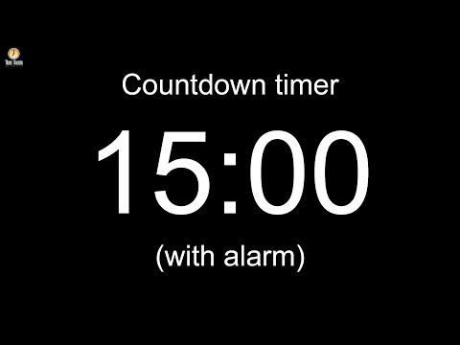
Notes:
Image source: AdobeStock_56885471

Slide 37
firewalld

Slide 38

Introducing firewalld
While UFW allows us to manage multiple networks devices over the command line, it has a major drawback:
Before firewall rules can be changed or modified, all firewall services must be stopped and restarted. This can be extremely disruptive to an organization’s operations.
For example: If you just brought a new host online, you would have to interrupt service on hundreds of other devices before creating a rule for this new host.
(Source)
Notes:
https://dribbble.com/shots/2750493-The-Corner-RESET-Animation

Slide 39

firewalld provides similar functionality to UFW but does not require the disruption of services when implementing firewall services.
‹#›
Notes:
Image source: shutterstock_1083618569

Slide 40
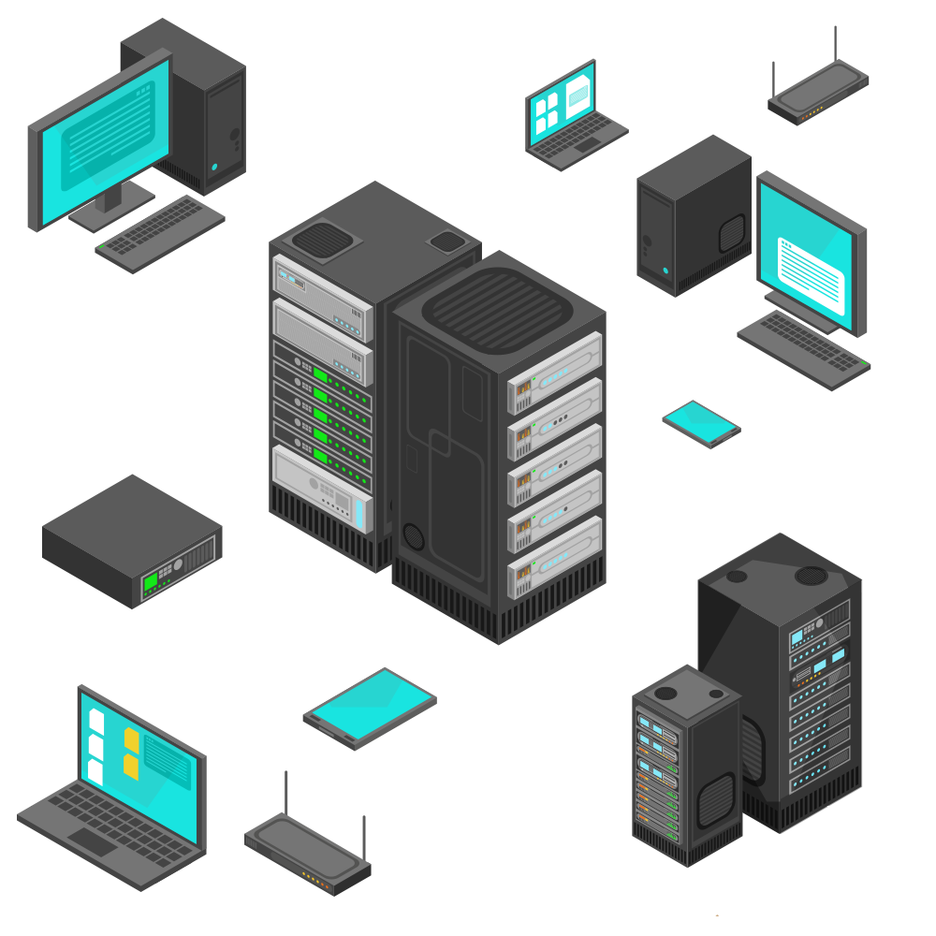

Introducing firewalld
firewalld is a dynamically managed firewall that uses zones to divide network interfaces into groups of shared trust level. The zones are assigned sets of rules depending on the needs and restrictions of each zone’s interfaces.
Zones are the organization of rules and each zone can contains several rules.
Through this division of zones, firewalld can manage rulesets dynamically, without breaking existing sessions, disrupting services, and bringing down the entire network.
Inside (trusted)
Outside (not trusted)
Internet
Notes:
Firewall: shutterstock_1214853796 Cloud: AdobeStock_184417876

Slide 41
Testing Rules with firewalld
Rules and configurations can be tested in runtime environments.
01
Runtime configurations
02
Permanent configurations
Valid until the next system reboot or service reload. Allows us to create settings that are active for a limited amount of time.
Can be used to test new configurations. Can then be seamlessly saved to permanent environment if deemed good and working.
Loaded with each reboot and reload and become the current runtime environment until new runtime configurations are made.

Slide 42
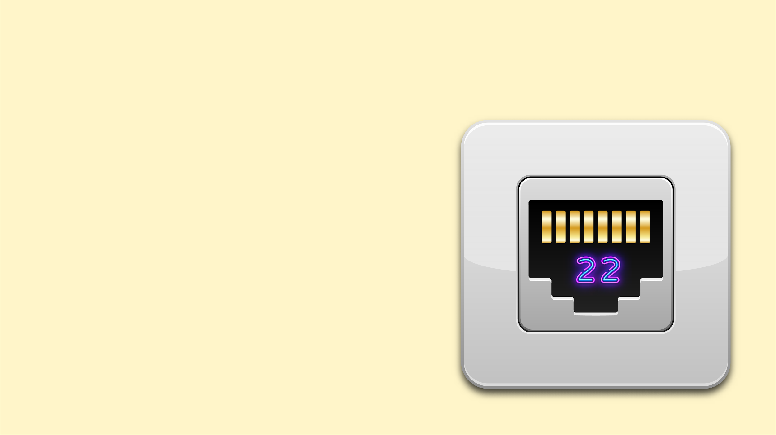

firewalld and Services
firewalld also uses services to easily configure rules.
By designating which services you want to allow, firewalld will automatically open the ports associated to those services.
For example: If you enable the SSH service in a zone, it will open port 22 without requiring you to specify the port number explicitly.
Services can be predefined, making it easy to configure the firewall rules most commonly required by most servers.
Notes:
Shutterstock_176521037 and Shutterstock_1126498814

Slide 43
Firewalld Demo
We will demonstrate firewalld using the following scenario:
An IT administrator is bringing a new Microsoft Active Directory server online. It will serve several new hosts on the third floor at the main office, which is serviced by eth1 on the firewall.
The administrator requested that this new network not be able to transmit or receive data from the Fifth Street office location, which uses an IP address of 10.10.0.10.
The administrator asked you to block all ICMP pings on that same interface as an extra level of protection.

Slide 44
firewalld

Slide 45
Activity: firewalld Configuration
In this activity, you will use firewall to add rules to various zones.
20 Minutes

Slide 47
Testing Rules with Nmap

Slide 48

Nmap
Nmap is the industry-standard network scanner.
(nmap)

Slide 49
Security professionals are faced with the never-ending task of defending networks against attacks. They are also expected to know, at all times, what is running on their networks, and any vulnerabilities that exist.
While there are many monitoring utilities available for performing network scans and security audits, nothing beats the versatility and useability of Nmap, the industry standard in performing network scans.

Slide 50

Nmap
Attackers can get the following from network scans:
Name and version of operating system (OS fingerprinting).
All open and closed ports.
All filtered ports (ports behind a firewall).
Types of services running on a specific port (service and daemon names).
Firewalking allows attackers to perform network analysis to determine which Layer 4 protocols a specific firewall allows.

Slide 51

Nmap Demo
In the following demonstration, we’ll perform scans against our UFW firewall. Consider the following scenario:
01
Your security manager has installed a brand new, fully-configured firewall and would like you to test it using Nmap.
02
You will use various fingerprinting techniques to reveal the type of operating system, services, daemons, and protocols currently running.
03
You will also test to see which ports are open, closed, and filtered.
Notes:
shutterstock_1095422036

Slide 52
Nmap

Slide 53
Activity: Testing Firewall Rules with Nmap
In this activity, you will perform various network scans to test firewall integrity.
10 Minutes

Slide 55
Questions?

